Slide 1
Lecture-1: Introduction to Microcontrollers
Fahmida Ahmed Antara,
Lecturer, Dept. of IRE

Slide 2


Microcontroller
A microcontroller is a compact integrated circuit designed to govern a specific operation in an embedded system. A typical microcontroller includes a processor, memory and input/output (I/O) peripherals on a single chip.
Sometimes referred to as an embedded controller or microcontroller unit (MCU), microcontrollers are found in vehicles, robots, office machines, medical devices, mobile radio transceivers, vending machines and home appliances, among other devices. They are essentially simple miniature personal computers (PCs) designed to control small features of a larger component, without a complex front-end operating system (OS).

Slide 3

Key Components of Microcontroller
The processor (CPU) : A processor can be thought of as the brain of the device. It processes and responds to various instructions that direct the microcontroller's function. This involves performing basic arithmetic, logic and I/O operations. It also performs data transfer operations, which communicate commands to other components in the larger embedded system.
Memory: A microcontroller's memory is used to store the data that the processor receives and uses to respond to instructions that it's been programmed to carry out. A microcontroller has two main memory types:
Program memory, which stores long-term information about the instructions that the CPU carries out. Program memory is non-volatile memory, meaning it holds information over time without needing a power source.
Data memory, which is required for temporary data storage while the instructions are being executed. Data memory is volatile, meaning the data it holds is temporary and is only maintained if the device is connected to a power source.

Slide 4



Continued…
I/O peripherals: The input and output devices are the interface for the processor to the outside world. The input ports receive information and send it to the processor in the form of binary data. The processor receives that data and sends the necessary instructions to output devices that execute tasks external to the microcontroller.
Other supporting elements of a microcontroller include:
Analog to Digital Converter (ADC) : An ADC is a circuit that converts analog signals to digital signals. It allows the processor at the center of the microcontroller to interface with external analog devices, such as sensors.
Digital to Analog Converter (DAC) : A DAC performs the inverse function of an ADC and allows the processor at the center of the microcontroller to communicate its outgoing signals to external analog components.
System bus: The system bus is the connective wire that links all components of the microcontroller together.
Serial port : The serial port is one example of an I/O port that allows the microcontroller to connect to external components. It has a similar function to a USB or a parallel port but differs in the way it exchanges bits.

Slide 5
Microprocessor
A microprocessor is a central processing unit (CPU) that serves as the "brain" of a computer or other electronic devices. It is an integrated circuit (IC) that contains the arithmetic logic unit (ALU), control unit, and registers, allowing it to execute instructions stored in the memory of a computer or electronic system.

Slide 6
Difference Between Microcontroller and Microprocessor
Content | Microcontroller | Microprocessor
Function | A microcontroller is a compact integrated circuit that includes a processor core, memory, and programmable input/output peripherals. | A microprocessor is a central processing unit (CPU) that focuses on executing general-purpose instructions. It lacks integrated peripherals for specific applications.
Purpose | Designed for specific tasks and applications in embedded systems. Often used in devices where control, automation, and real-time processing are crucial. | Typically used as the central computing unit in a broader system, requiring external components (memory, I/O devices) to complete a functional system.
Integration of Components | Includes integrated peripherals like timers, counters, ADC (Analog-to-Digital Converter), UART (Universal Asynchronous Receiver-Transmitter), and more. | Does not have built-in peripherals for specific tasks. Relies on external components for memory, I/O, and other functions.

Slide 7
Continued…
Content | Microcontroller | Microprocessor
Complexity | Designed for specific applications, resulting in a lower overall complexity. | General-purpose design increases overall complexity.
Cost | Often more cost-effective for targeted applications. | May be more expensive due to additional components required for a complete system.
Execution Speed | Typically operates at lower clock speeds suitable for specific applications | Operates at higher clock speeds, providing greater computational power for general-purpose computing tasks.
Applications | Commonly used in embedded systems and specific applications, such as automotive control units, industrial automation, and consumer electronics. | Used in general-purpose computing devices like personal computers, laptops, servers, and workstations.
Examples | Atmel AVR series, Microchip PIC series, and ARM Cortex-M series. | Intel Core processors (x86 architecture), AMD processors, and ARM Cortex-A series.

Slide 8
Types of Microcontroller
8-bit Microcontrollers: : Atmel AVR, Microchip PIC12/PIC16, 8051.
16-bit Microcontrollers: Microchip PIC24, Renesas RX, Freescale HCS12.
32-bit Microcontrollers: ARM Cortex-M series (e.g., Cortex-M0, M3, M4), PIC32, STM32.
ARM-based Microcontrollers: STM32 (STMicroelectronics), LPC series (NXP), SAM series (Atmel/Microchip).
Digital Signal Processors (DSPs): TMS320 series (Texas Instruments), ADSP series (Analog Devices).
Application-Specific Microcontrollers: Motor control microcontrollers, automotive microcontrollers, and smart metering microcontrollers.
Wireless Microcontrollers: ESP8266 (Wi-Fi), nRF52 series (Bluetooth), CC26xx (TI, Zigbee).

Slide 9
AVR ATmega32 Microcontroller
The ATmega32 follows the AVR architecture, which is based on a modified Harvard architecture. This architecture separates program memory (Flash) and data memory (SRAM).
It is an 8-bit microcontroller, meaning it processes data in 8-bit chunks.
Typically includes 32 KB of Flash memory for program storage.
Has 2 KB of SRAM for data storage.
Features 1 KB of EEPROM for non-volatile data storage.
The ATmega32 can operate at different clock speeds, often ranging from a few MHz to around 16 MHz.
The ATmega32 has multiple I/O pins organized into ports, making it suitable for interfacing with external devices.
Features power-saving modes to optimize energy consumption, including sleep modes.
The ATmega32 is supported by various development tools, including compilers (such as AVR-GCC), integrated development environments (IDEs), and programmers.
The ATmega32 is commonly used in a wide range of applications, including embedded systems, robotics, industrial control, consumer electronics, and educational projects.

Slide 10
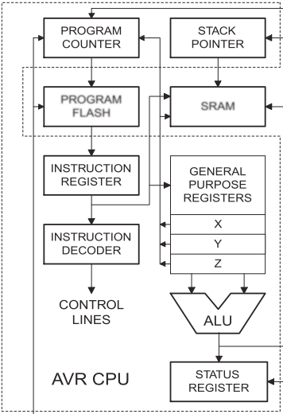
AVR Microcontroller Architecture

Slide 11
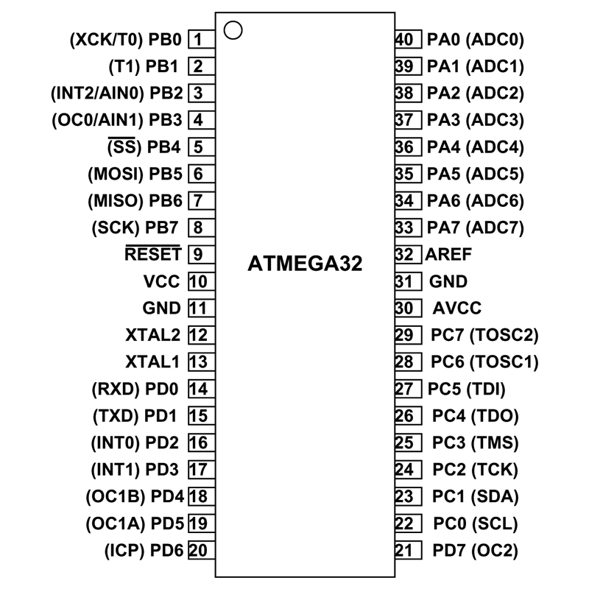
Pin diagram of ATmega32
9 | Reset | Reset Pin, Active Low Reset
10 | Vcc | Vcc = +5V
11 | GND | GROUND
12 | XTAL2 | Connected to Crystal Oscillator
13 | XTAL1 | Connected to Crystal Oscillator
31 | GND | GROUND

Slide 12
Intel 8051 Microcontroller
The Intel 8051 is a classic microcontroller that was introduced in 1980. It follows the Von Neumann architecture, where program memory and data memory share the same address space.
The Intel 8051 is an 8-bit microcontroller.
Typically includes on-chip ROM (Read-Only Memory) for program storage and on-chip RAM for data storage.
Some versions may support external memory expansion.
Integrated peripherals such as timers/counters, serial communication (UART), I/O ports, interrupt controller, etc.
Known for its versatile I/O capabilities.
The 8051 microcontroller has a CISC (Complex Instruction Set Computing) architecture with a relatively large and diverse instruction set.
The 8051 microcontroller has been widely used in various applications, including industrial control, automotive systems, home appliances, and more.
It is known for its historical significance and widespread adoption in the early days of microcontroller-based systems.

Slide 13
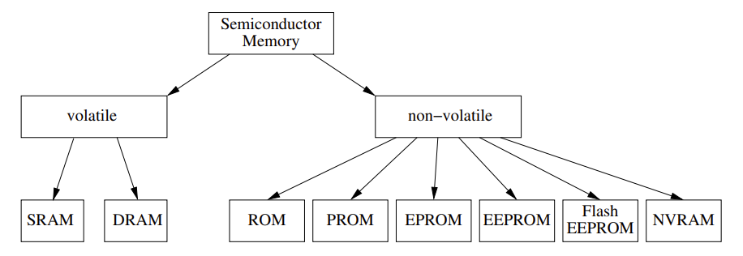
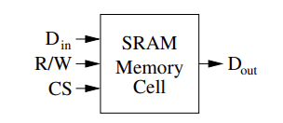
Types of Memory
Static RAM (SRAM):
An SRAM chip consists of an array of cells, each capable of storing one bit of information. To store a bit of information, a so-called flip-flop is used, which basically consists of six transistors.
SRAM cell has the following inputs and outputs:
Din = Data In: On this input, the cell accepts the one bit of data to be stored.
R/W= Read/Write: Via the logical value at this input, the type of access is specified: 0 means the cell is to be written to, i.e., the current state of Din should be stored in the cell. 1 means that the cell is to be read, so it should set Dout to the stored value.
CS= Cell Select: As long as this input is logical 0, the cell does not accept any data present at Din and keeps its output Dout in a so-called high resistance state, which effectively disconnects it from the rest of the system. On a rising edge, the cell either accepts the state at Din as the new bit to store, or it sets Dout to the currently stored value.
Dout= Data Out: This output reflects the bit that is stored in the cell

Slide 14
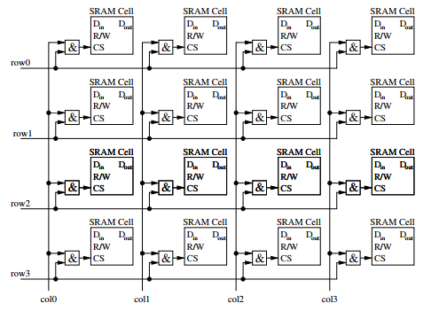
Continued…
Figure: A matrix of memory cells in an SRAM

Slide 15
Continued…
Dynamic RAM (DRAM):
Unlike static RAM (SRAM), which uses flip-flops to store a bit of data, DRAM uses a capacitor and transistor to store each bit. The capacitor holds the charge representing the binary value (0 or 1), and the transistor acts as a switch that allows the control circuitry on the memory chip to read the capacitor's state or change it. The dynamic nature of DRAM arises from the fact that the charge in the capacitors gradually leaks away over time. Therefore, to retain the information, the data needs to be periodically refreshed, typically every few milliseconds. This refresh process consumes additional power but allows DRAM to provide a high-density, cost-effective solution for storing large amounts of data that can be accessed quickly.

Slide 16
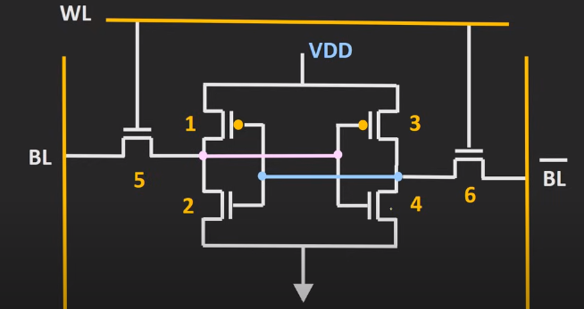
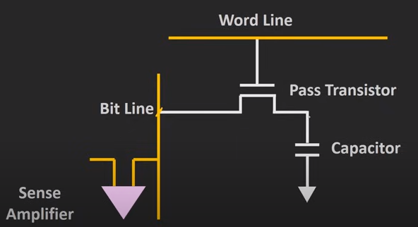
Continued…
SRAM DRAM

Slide 17
Thank You!

